Slide 1
MIXED REALITY INTERACTIONS
PRESENTED BY
PRISHITA SINGH
22306048
SUPERVISOR: Professor John Dingliana

Slide 2

Contents
Research Canvas | Motivation Statement | Research Gantt Chart | Ethical Approval
 | Skills | References

Slide 3
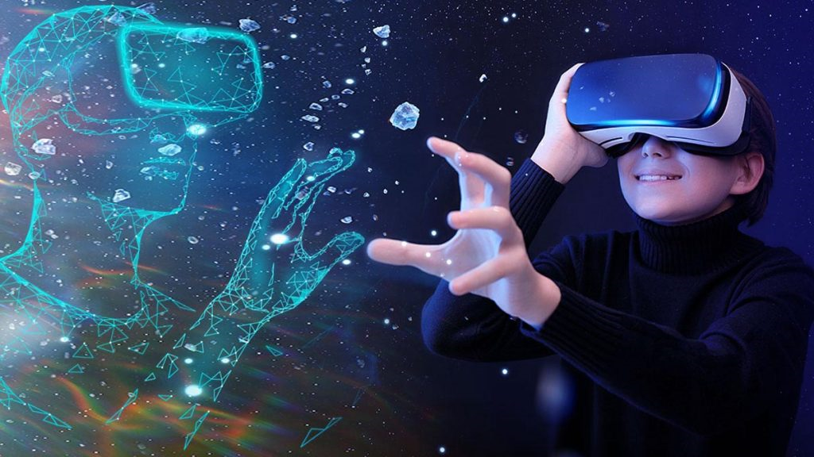
Motivation Statement
Virtual Reality and games are booming industries. In order to have a seamless experience in both the cases, it is necessary to have quick response time and no interruptions.
Despite multiple advancements a lot needs to be achieved as lags are common part in most of such interactions. Moreover, with the advent of VR headsets, they are majorly used in such events.
Instead of following the conventional pattern, we would use projections while creating the virtual game, created from the scratch and improve lags.

Slide 4
Student Name: PRISHITA SINGH | Student ID: 22306048 | Stream: M.Sc. Computer Science (Augmented & Virtual Reality) | Supervisor Name: Professor John Dingliana
Research Question/Aim : Mixed Reality Interaction – Using hand movements and gestures to play a virtually created game without using VR headsets
2. Research Objectives Ability of the system to track hand gestures of different people Enhancing the response time so that the movements are tracked efficiently and there are no lags in virtual environment |  | 3. Approach/Method to achieve objectives Tracking different kind of hands movements and gestures Integrating the real movements, i.e. hands with the virtual movements, i.e., the game Collision Detection and Response in a Mixed (Real & Virtual) environment Creation of Virtual game, Air Hockey
4. Evaluation Comparison of performance of different mixed reality games response time. Tracking ability to track hand movements of various people.
5. Contribution of your research project. Enhancing Mixed Reality Interactions without Virtual Reality Headset

Slide 5
GANTT CHART
MIXED REALITY INTERACTIONS
SEP | OCT | NOV | DEC | JAN | FEB | MAR | APR | MAY | JUN | JUL | AUG
OPENGL, PYTHON, C++
PLANNING
COLLISION DETECTION
COLLISION RESPONSE
PREVIOUS RESEARCH
PAPERS
RESEARCH
HAND GESTURE DETECTION
OPENGL GAME
INTEGRATING GESTURES WITH GAME
IMPLEMENTATION
FIXING BUGS
RESULTS, REPORT WRITING
FINALISAE
REPORT
FINALIZING

Slide 6
Skills Required
Technical Skills Programming Languages Python OpenGL C++ Python Statistical Measures and Analysis
Research Skills Report Writing Presentation Skills Planning and Scheduling Innovative Approach

Slide 7
Ethical Approval
NO, Ethical Approval is not required in this project.
This project involves human interactions with a
machine. If any user agree to play the game then
no personal data would be recorded.

Slide 8
References
Maximilian Speicher, Brian D. Hall, and Michael Nebeling. 2019. What is Mixed Reality? In Proceedings of the 2019 CHI Conference on Human Factors in Computing Systems (CHI '19). Association for Computing Machinery, New York, NY, USA, Paper 537, 1–15. https://doi.org/10.1145/3290605.3300767
Richard Nguyen. 2022. Integrating in-hand physical objects in mixed reality interactions. In 27th International Conference on Intelligent User Interfaces (IUI '22 Companion). Association for Computing Machinery, New York, NY, USA, 129–133. https://doi.org/10.1145/3490100.3516476
Andrew Clark and Deshendran Moodley. 2016. A System for a Hand Gesture-Manipulated Virtual Reality Environment. In Proceedings of the Annual Conference of the South African Institute of Computer Scientists and Information Technologists (SAICSIT '16). Association for Computing Machinery, New York, NY, USA, Article 10, 1–10. https://doi.org/10.1145/2987491.2987511
Céline Coutrix and Laurence Nigay. 2006. Mixed reality: a model of mixed interaction. In Proceedings of the working conference on Advanced visual interfaces (AVI '06). Association for Computing Machinery, New York, NY, USA, 43–50. https://doi.org/10.1145/1133265.1133274
Alexander Schäfer, Gerd Reis, and Didier Stricker. 2022. The Gesture Authoring Space: Authoring Customised Hand Gestures for Grasping Virtual Objects in Immersive Virtual Environments. In Proceedings of Mensch und Computer 2022 (MuC '22). Association for Computing Machinery, New York, NY, USA, 85–95. https://doi.org/10.1145/3543758.3543766
https://www.learnopengles.com/adding-a-3d-perspective-and-object-rendering-to-our-air-hockey-project-in-native-c-code/
https://www.learnopengles.com/category/air-hockey-project/

Slide 9
THANK YOU!!!!

